Slide 1
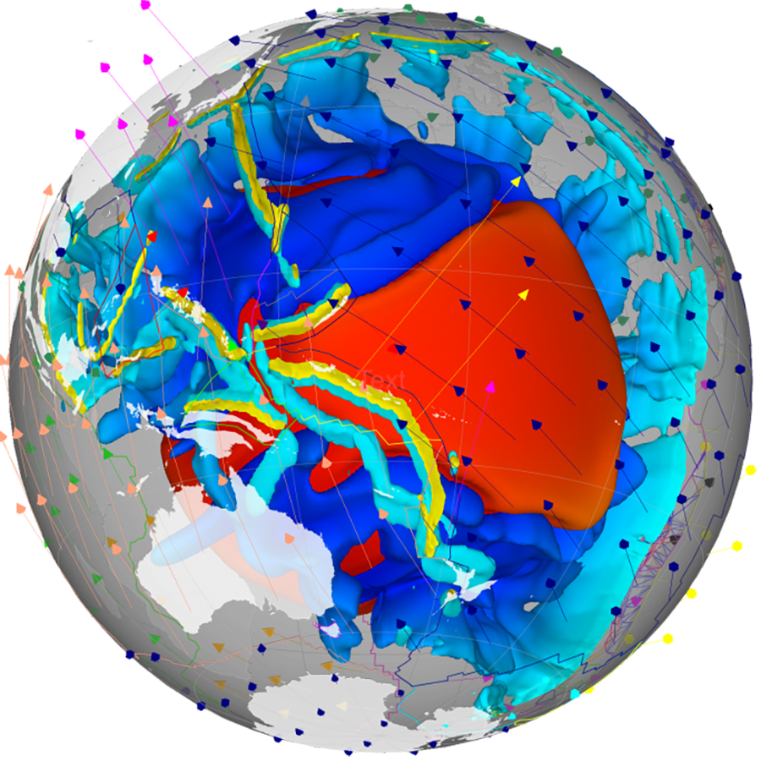
GPlates
Interactive Tectonic Models
Elizabeth M. Dowding
May, 2024
dowdingem@gmail.com

Slide 2
Introduction to learning outcomes
Session 1
Introduction to theory
Session 2
Introduction to using GPlates
Practical guide to picking a plate reconstruction (reference frames)
Session 3
Using a plate reconstruction
Assignment
Group task
https://adamtkocsis.com/se3-gplates/

Slide 3
Assignment
Practical exercise with GPlates
Short report (max. 3 A4 pages)
Assignment can be written in German
Due until the end of the lecture period (July) - necessary to pass the course
https://adamtkocsis.com/se3-gplates/assignment/
The Assignment | GPlates for System Erde III.
Notes:
The Assignment | GPlates for System Erde III. (adamtkocsis.com)

Slide 4
Downloading GPlates
Tutorial:
https://adamtkocsis.com/se3-gplates/setup/
GPlates Site:
GPlates
https://www.gplates.org/

Slide 5
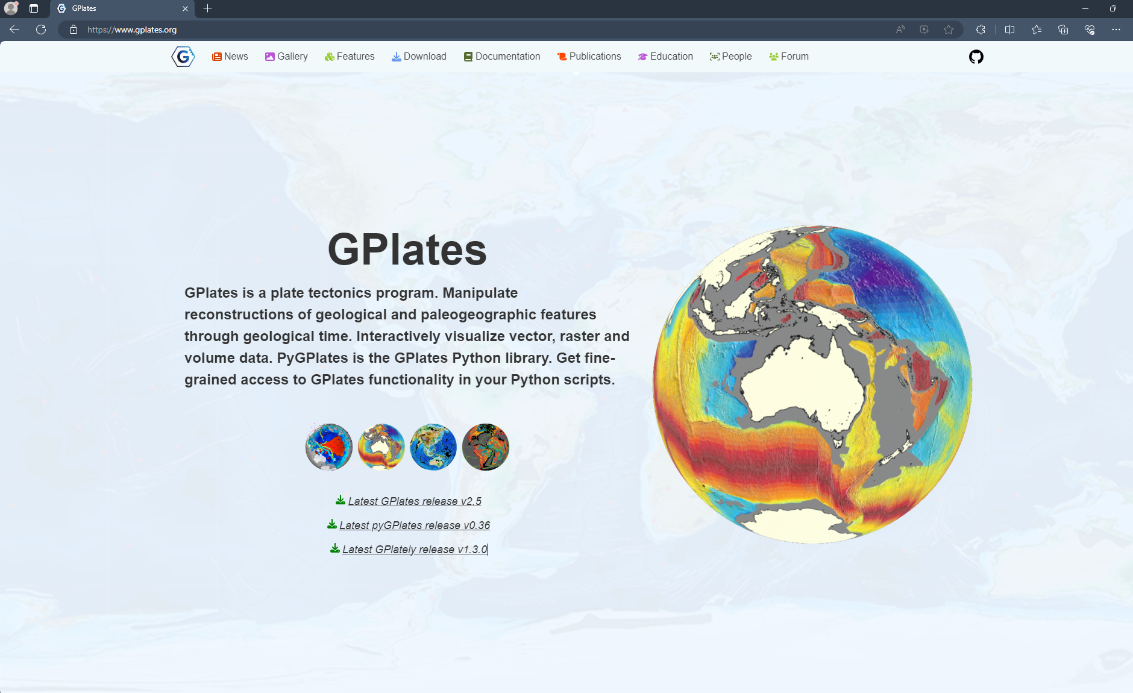
Please refer to the tutorial for a full pictural walkthrough : https://adamtkocsis.com/se3-gplates/setup/

Slide 6
Revision
Plate tectonics is the theory that underpins plate reconstructions
Plate Tectonics is the mechanistic theory that explains continental drift, sea floor spreading, subduction, orogeny, basin development etc.
Oceanic crust (non-trapped) is no older than c.200 million years.
Evidence includes: hot spots, palaeomagentics, geometric fit of the continents, mid-ocean ridges, biogeography, facies distribution, GPS coordinates, amongst others.

Slide 7
Ocean-plate age
Notes:
Maps of the age of oceanic plates, which varies between 0 and around 200 Ma due to ongoing plate motion and recycling (i.e., ocean-plate tectonics). Global ocean-plate age data from Müller et al. (1997) visualised on a custom Interrupted Mollweide map projection from Crameri et al. (2020) focussing on the World’s oceans. The Scientific colour map ‘batlow‘ is used to represent data accurately and to all readers.
Creator: Fabio Crameri
This version: 20.08.2021
License: Attribution-ShareAlike 4.0 International (CC BY-SA 4.0)
Specific citation: This graphic by Fabio Crameri from Crameri et al. (2022) is available via the open-access s-Ink.org repository.
Related references: Crameri, F., G.E. Shephard, and E.O. Straume (2022, Pre-print), Effective high-quality science graphics from s-Ink.org, EarthArXiv, https://doi.org/10.31223/X51P78 Müller, R. D., et al. (1997). “Digital isochrons of the world’s ocean floor.” J. Geophys. Res. 102(B2): 3211-3214. Crameri, F., V. Magni, M. Domeier, G.E. Shephard, K. Chotalia, G. Cooper, C. Eakin, A.G. Grima, D. Gürer, A. Király, E. Mulyukova, K. Peters, B. Robert, and M. Thielmann (2020), A transdisciplinary and community-driven database to unravel subduction zone initiation, Nature Communications, 11, 3750. doi:10.1038/s41467-020-17522-9

Slide 8
The Wilson Cycle
How to make and unmake Pangea
Notes:
The birth of ocean basins

Slide 10
Session 2: Reference Frames
Palaeomag
Hotspot
Mantle

Slide 11
Session 2: Reference Frames
Palaeomag
Hotspot
Mantle reference frame

Slide 12
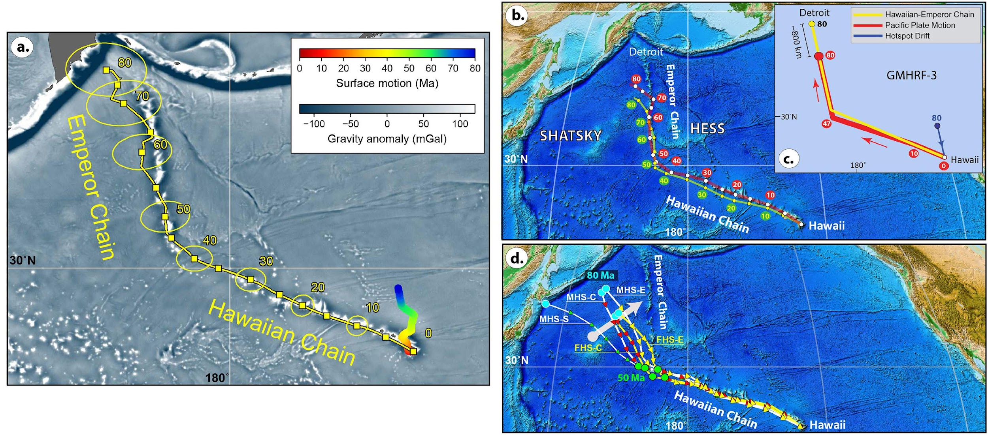
Plates move above a hotspot
Notes:
Torsvik et al, 2019

Slide 13
But how does this all happen?

Slide 14
Mantle convection (mobile-lid)
Notes:
Movie showing the temporal evolution of a global, fully spherical, 3D model of whole-mantle convection with hot temperature isosurface (red) and stiff viscosity isosurfaces (grey).
Creator: Fabio Crameri
This version: 07.08.2021
License: Attribution-ShareAlike 4.0 International (CC BY-SA 4.0)
Specific citation: This graphic by Fabio Crameri from Crameri and Tackley (2016) is available via the open-access s-Ink.org repository.
Related reference: Crameri, F., and P. J. Tackley (2016), Subduction initiation from a stagnant lid and global overturn: new insights from numerical models with a free surface, Progress in Earth and Planetary Science, 3(1), 1–19, doi:10.1186/s40645-016-0103-8

Slide 15
Earth’s mantle heterogeneity theories
Notes:
Creator: Anna Gülcher
This version: 17.12.2022
License: Attribution-ShareAlike 4.0 International (CC BY-NC-SA 4.0)
Specific citation: These graphics by Anna Gülcher from Gülcher et al. (2021) are available via the open-access s-Ink.org repository.
Related reference: Gülcher, A. J. P., Ballmer, M. D., and Tackley, P. J. (2021), Coupled dynamics and evolution of primordial and recycled heterogeneity in Earth’s lower mantle, Solid Earth, 12, 2087–2107, 2021 https://doi.org/10.5194/se-12-2087-2021

Slide 16
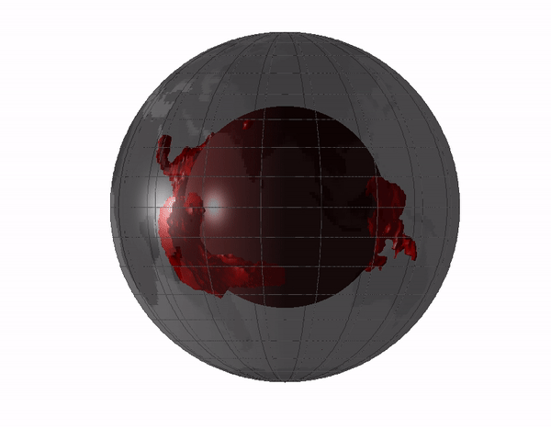
Large Low-Shear-Velocity Province
3% slower than the rest of the mantle
Thermochemical piles: near antipodal and equatorial.
Their edges are ‘plume generation zones’ and can impact the Wilson cycle.
LLSVPs are thermal insulator, making core heating effective at their edges for mantle plumes.
Notes:
Origin of the LLSVPs at the base of the mantle is a consequence of plate tectonics – A petrological and geochemical perspective - ScienceDirect

Slide 17
Seismic mantle tomography maps
Notes:
Surface projected global horizontal seismic S-wave velocity anomaly maps for different mantle depths revealing the two large low shear-wave velocity provinces (LLSVPs) below the Pacific (named Jason) and Africa (named Tuzo). Shown is the S10MEAN model based on Doubrovine et al. (2016) averaging 10 tomography models allowing to compare relative variations in S-wave velocity. The Scientific colour map ‘batlow‘ is used to represent data accurately and to all readers.
Creator: Fabio Crameri
This version: 31.10.2021
License: Attribution-ShareAlike 4.0 International (CC BY-SA 4.0)
Specific citation: This graphic by Fabio Crameri based on data compiled by Doubrovine et al. (2016) is available via the open-access s-Ink repository.
Related references: Doubrovine, P. V., Steinberger, B., and Torsvik, T. H. (2016), A failure to reject: Testing the correlation between large igneous provinces and deep mantle structures with EDF statistics, Geochem. Geophys. Geosyst., 17, 1130– 1163, doi:10.1002/2015GC006044.

Slide 18
Seismic mantle tomography maps
Jason
Jason
Tuzo
Notes:
Surface projected global horizontal seismic S-wave velocity anomaly maps for different mantle depths revealing the two large low shear-wave velocity provinces (LLSVPs) below the Pacific (named Jason) and Africa (named Tuzo). Shown is the S10MEAN model based on Doubrovine et al. (2016) averaging 10 tomography models allowing to compare relative variations in S-wave velocity. The Scientific colour map ‘batlow‘ is used to represent data accurately and to all readers.
Creator: Fabio Crameri
This version: 31.10.2021
License: Attribution-ShareAlike 4.0 International (CC BY-SA 4.0)
Specific citation: This graphic by Fabio Crameri based on data compiled by Doubrovine et al. (2016) is available via the open-access s-Ink repository.
Related references: Doubrovine, P. V., Steinberger, B., and Torsvik, T. H. (2016), A failure to reject: Testing the correlation between large igneous provinces and deep mantle structures with EDF statistics, Geochem. Geophys. Geosyst., 17, 1130– 1163, doi:10.1002/2015GC006044.

Slide 21
Where, what, and why?
(1) subduction of the ocean crust of basaltic composition (SOC)to the lower mantle is irreversible because SOC is denser than the ambience of peridotitic composition under lower mantle conditions in both solid state and liquid form

Slide 22
Where, what, and why?
subduction of the ocean crust of basaltic composition (SOC)to the lower mantle is irreversible because SOC is denser than the ambience of peridotitic composition under lower mantle conditions in both solid state and liquid form;
SOC is the best candidate for the LLSVPs composition, which are, in turn, the permanent graveyard of SOC.

Slide 23
Where, what, and why?
subduction of the ocean crust of basaltic composition (SOC)to the lower mantle is irreversible because SOC is denser than the ambience of peridotitic composition under lower mantle conditions in both solid state and liquid form;
SOC is the best candidate for the LLSVPs composition, which are, in turn, the permanent graveyard of SOC.
the LLSVPs act as thermal insulators, making core-heating induced mantle diapirs or plumes initiated at their edges, which explains why the large igneous provinces (LIPs) are associated with the edges of the LLSVPs

Slide 24
Where, what, and why?
subduction of the ocean crust of basaltic composition (SOC)to the lower mantle is irreversible because SOC is denser than the ambience of peridotitic composition under lower mantle conditions in both solid state and liquid form;
SOC is the best candidate for the LLSVPs composition, which are, in turn, the permanent graveyard of SOC.
the LLSVPs act as thermal insulators, making core-heating induced mantle diapirs or plumes initiated at their edges, which explains why the large igneous provinces (LIPs) are associated with the edges of the LLSVPs
The antipodal positioning of Jason and Tuzo represents the optimal momentum of inertia, which explains why the LLSVPs are stable in the spinning Earth.

Slide 25
Where, what, and why?
subduction of the ocean crust of basaltic composition (SOC)to the lower mantle is irreversible because SOC is denser than the ambience of peridotitic composition under lower mantle conditions in both solid state and liquid form;
SOC is the best candidate for the LLSVPs composition, which are, in turn, the permanent graveyard of SOC.
the LLSVPs act as thermal insulators, making core-heating induced mantle diapirs or plumes initiated at their edges, which explains why the large igneous provinces (LIPs) are associated with the edges of the LLSVPs
The antipodal positioning of Jason and Tuzo represents the optimal momentum of inertia, which explains why the LLSVPs are stable in the spinning Earth.
EXTREMELY CONTENTIOUS
Notes:
Origin of the LLSVPs at the base of the mantle is a consequence of plate tectonics – A petrological and geochemical perspective - ScienceDirect

Slide 26
Earth’s mantle heterogeneity theories
Debate: What effect would each of these have on plate reconstruction? On Earth history?
Notes:
Creator: Anna Gülcher
This version: 17.12.2022
License: Attribution-ShareAlike 4.0 International (CC BY-NC-SA 4.0)
Specific citation: These graphics by Anna Gülcher from Gülcher et al. (2021) are available via the open-access s-Ink.org repository.
Related reference: Gülcher, A. J. P., Ballmer, M. D., and Tackley, P. J. (2021), Coupled dynamics and evolution of primordial and recycled heterogeneity in Earth’s lower mantle, Solid Earth, 12, 2087–2107, 2021 https://doi.org/10.5194/se-12-2087-2021

Slide 27
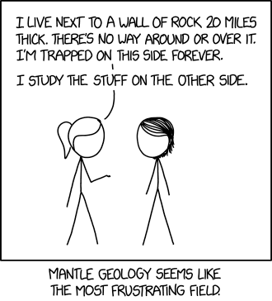

Slide 28
Are they LLSVPs stable? Why does it matter?
Can they be used as latitudinal markers?
The locations of LIPS
The impact on plate motions
The mechanism driving plate tectonics itself.
The debate continues. This is relevant for the TC2019 model and its approach to longitude Torsvik and Cocks 2019

Slide 30
Session 2: Reference Frames
Palaeomagnetic reference frame
Hotspot
Mantle

Slide 31
Notes:
Merdith et al 2021.
Add it all together (with a few other things) and you get yourself a Plate Reconstruction.
Tectonic time-lapse: One billion years of Earth’s history in 40 seconds

Slide 34
The Geodynamo hypothesis
In physics, the dynamo theory proposes a mechanism by which a celestial body such as Earth or a star generates a magnetic field. The dynamo theory describes the process through which a rotating, convecting, and electrically conducting fluid can maintain a magnetic field over astronomical time scales
Proposed to have existed as early as 3Byr
Notes:
Geodynamo (ucsc.edu)

Slide 35
Notes:
A snapshot of the region (yellow) where the fluid flow is the greatest. The core-mantle boundary is the blue mesh; the inner core boundary is the red mesh. Large zonal flows (eastward near the inner core and westward near the mantle) exist on an imaginary "tangent cylinder" due to the effects of large rotation, small fluid viscosity, and the presence of the solid inner core within spherical shell of the outer fluid core

Slide 37
The 2013 Solar Storm
On May 13, 2013, an X2.8-class flare erupted from the sun - the strongest flare of 2013 to date. This image of the flare, shown in the upper left corner, was captured by NASA's Solar Dynamics Observatory in light of 131 angstroms, a wavelength which is particularly good for capturing the intense heat of a solar flare and which is typically colorized in teal. Credit: NASA/SDO
Notes:
Three X-class Flares in 24 Hours | NASA

Slide 38
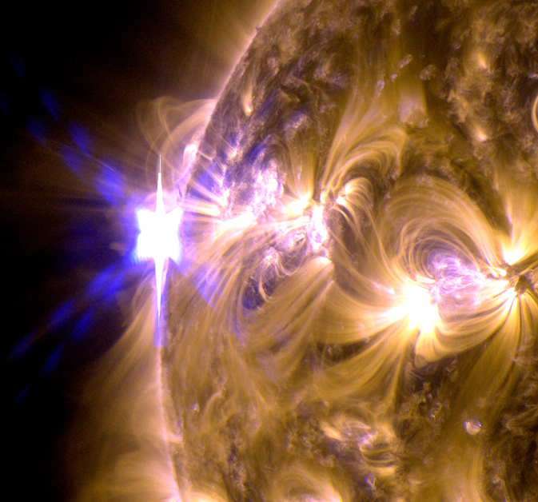
The 2013 Solar Storm
On May 13, 2013, an X2.8-class flare erupted from the sun - the strongest flare of 2013 to date. This image of the flare, shown in the upper left corner, was captured by NASA's Solar Dynamics Observatory in light of 131 angstroms, a wavelength which is particularly good for capturing the intense heat of a solar flare and which is typically colorized in teal. Credit: NASA/SDO
Notes:
Three X-class Flares in 24 Hours | NASA

Slide 39
And for Plate Tectonics?

Slide 40
What is Gplates?
GPlates is desktop software for the interactive visualisation of plate tectonics.
GPlates offers a novel combination of interactive plate tectonic reconstructions, geographic information system (GIS) functionality and raster data visualisation. GPlates enables both the visualisation and the manipulation of plate tectonic reconstructions and associated data through geological time.

Slide 41
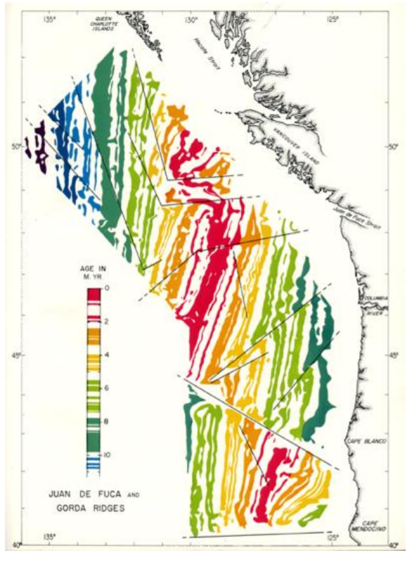
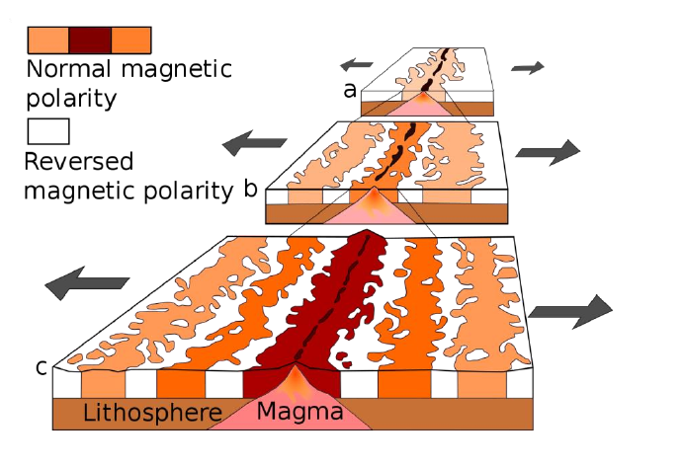
Palaeomagnetic stripes

Slide 42
Apparent Polar Wander

Slide 43
Notes:
https://www.youtube.com/watch?v=_0mdH8NtJXE

Slide 44
Apparent Polar Wander

Slide 45
More than lines: results in rock
Notes:
Illustration of how plates move across the Earth. The motion of (almost) rigid surface portions on a sphere can be described by a rotation around a rotation axis, which cuts the surface at the so-called Euler pole. This relative motion of the plates is mainly accommodated by localised deformation at plate boundaries. Three general types of plate boundaries exist: transform plate boundaries allow the plates to move alongside each other, and convergent and divergent plate boundaries allow for plate destruction and creation, respectively. Transform and divergent plate boundaries are almost straight features, but spreading ridges are generally offset laterally by transform intersections. Subduction zones are usually arcuate (i.e., concave toward the upper plate) due to interaction with mantle flow. Variations of these plate boundaries exist depending on the given combination of upper and lower plate nature (i.e., continental or oceanic).
Creator: Fabio Crameri
This version: 23.08.2021
License: Attribution-ShareAlike 4.0 International (CC BY-SA 4.0)
Specific citation: This graphic by Fabio Crameri from Crameri et al. (2019) is available via the open-access s-Ink repository.
Related reference: Crameri, F., G.E. Shephard, and C.P. Conrad, (2019), Plate Tectonics☆, Reference Module in Earth Systems and Environmental Sciences, Elsevier, doi:10.1016/B978-0-12-409548-9.12393-0

Slide 46
True Polar Wander
Notes:
Comparison of plate motions assuming a fixed hotspot framework indicates that TPW has amounted to about 12° since the Early Tertiary. Because TPW affects equally all calculated poles of a given age in the same way, however, it does not usually influence relative plate motions deduced from APW paths.

Slide 47
True Polar Wander
TPW results from changes in the magnetic pole position caused by global slip at the core-mantle boundary, at least in part in response to changes in mass redistribution at the surface caused by the formation and breakup of supercontinents. Movement of the entire lithosphere with respect to the mantle or of the mantle relative to the core can produce the same effect.
Notes:
Comparison of plate motions assuming a fixed hotspot framework indicates that TPW has amounted to about 12° since the Early Tertiary. Because TPW affects equally all calculated poles of a given age in the same way, however, it does not usually influence relative plate motions deduced from APW paths.

Slide 48
True Polar Wander
Formal definition:
As defined as the migration of the maximum moment of inertia (I_{max}) to. align with Earth’s spin axis, TPW occurs as a rotation about an Euler pole controlled by the minimum moment of inertia (I_{min}) that is equatorial and is therefore predicted to circumscribe a great-circle APW path
Notes:
Comparison of plate motions assuming a fixed hotspot framework indicates that TPW has amounted to about 12° since the Early Tertiary. Because TPW affects equally all calculated poles of a given age in the same way, however, it does not usually influence relative plate motions deduced from APW paths.

Slide 49
Earth is a spinning ball in space.
Notes:
APW is earth relative.
TPW corrected for earths situation in the cosmos

Slide 50
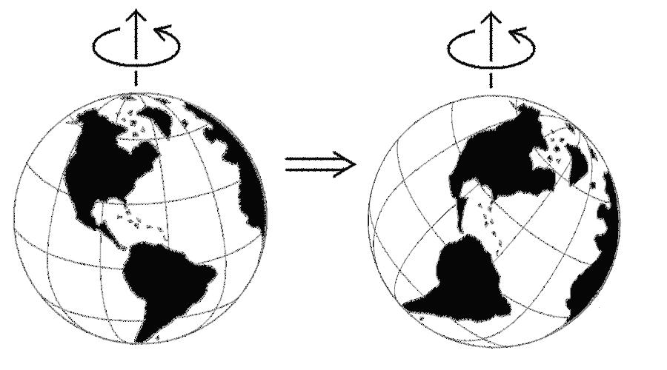
True Polar Wander: consider reconstruction
Notes:
The arrangement is the same. The latitudes are very different.

Slide 51
True Polar Wander: observable events
Jing et al 2022.
Notes:
a True polar wander (TPW) angle as a function of time with an initial condition of 25°. b TPW speed (black line) and probability function (shaded gray) as a function of time.
https://www.nature.com/articles/s41467-022-35609-3 TPW in the middle of the event. A simple simulation (Methods) demonstrates that it is 20 times less likely to sample TPW “in action” than the endpoints largely before/after the TPW event

Slide 52
In GAD we trust

Slide 53
Which do you pick?
The PMRF has problems
The MRF has problems
Notes:
Mantle reference frames use mantle features such as upwellings and subducted slabs as an absolute reference to plate motion. These reference frames do not always reflect the true position of past continents as they neglect true polar wander. This is shown in the figure with the implied spin axis of the Earth in a mantle frame actually in a different place in the paleomagnetic frame due to a shifting of the plate-mantle system relative to the core. Image by Rachel O’Brien and based on Conrad et al, 2013. Which to use depends on your question. For people using climatically sensitive data (fossils, facies, etc) you must use the PMRF RIGHT NOW. But they are working towards integrating the two models and there are mixed versions for younget years (hotspot models are these)

Slide 54
The way you think about a problem will ALWAYS impact the product.

Slide 55
True Polar Wander: a reminder
Notes:
https://youtu.be/UEEFlmxVh94

Slide 56
What is GPlates?
Developed by community effort
New Version released this year to include subduction arrows.
Current challenge: deformation!

Slide 57
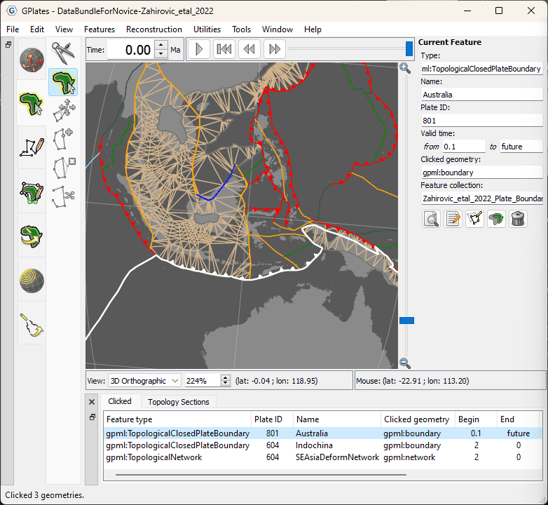
NEW!
Version 2.5
April, 2024.

Slide 58
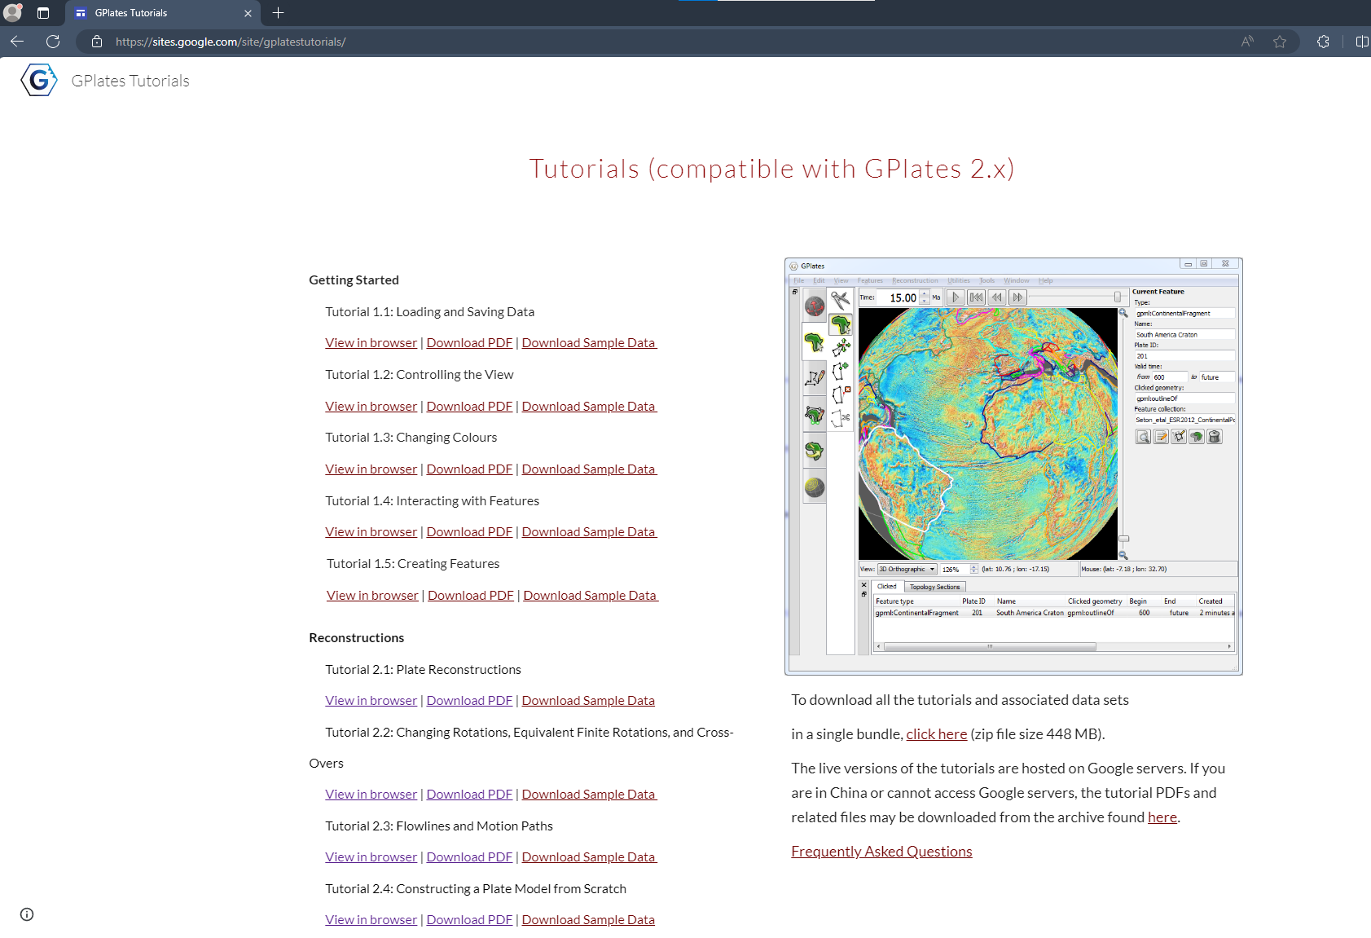

Slide 59
TODAY
21st May
Notes:
Alternatively: GPlates for System Erde III. | This website contains exercise material for the Dynamik des Systems Erde - System Erde III. class. // https://adamtkocsis.com/se3-gplates/

Slide 60
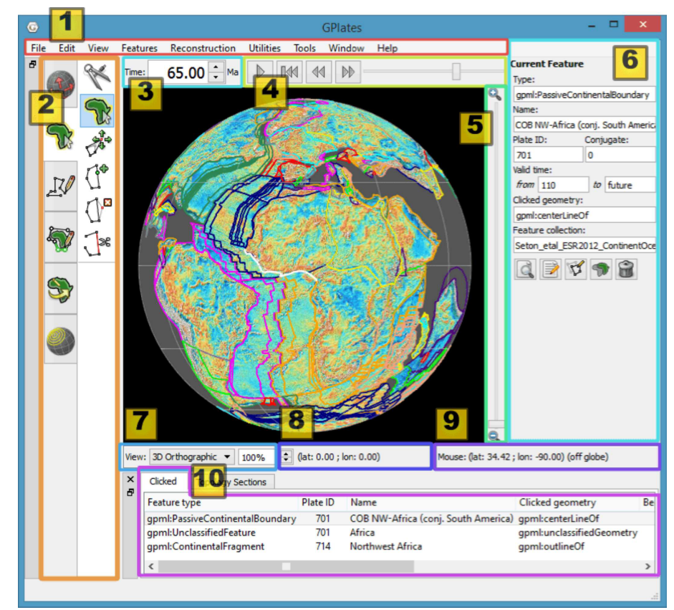
GPlates
Item | Name | Description
1 | Menu Bar | This region of the Main Window contains the titles of the menus.
2 | Tool Palette | A collection of tools which are used to interact with the globe and geological features via the mouse pointer.
3 | Time Controls | A collection of user-interface controls for precise control of the reconstruction time.
4 | Animation Controls | A collection of tools to manipulate the animation of reconstructions.
5 | Zoom Slider | A mouse-controlled slider which controls the zoom level of the Globe View camera.
Notes:
https://www.gplates.org/docs/user-manual/Introducing_The_Main_Window/

Slide 61
GPlates
Item | Name | Description
6 | Task Panel | Task-specific information and controls which correspond to the currently-activated tool.
7 | View Control | Controls which projection is used to display data and the exact zoom level as a percentage.
8 | Camera Coordinate | An information field which indicates the current globe position of the Globe View camera.
9 | Mouse Coordinate | An information field which indicates the current globe position of the mouse pointer.
10 | Clicked Geometry Table | Displays a summary of each geometry or feature touched by the last mouse click.
Notes:
https://www.gplates.org/docs/user-manual/Introducing_The_Main_Window/

Slide 62
Tutorial Options
System Erde III, ATK
https://adamtkocsis.com/se3-gplates/features/
GPlates
https://docs.google.com/document/d/1aaEBeI2Ixszj5xMCxFDF4Ucr9RiHCJ3cWZJVvvDEKBA/pub

Slide 63
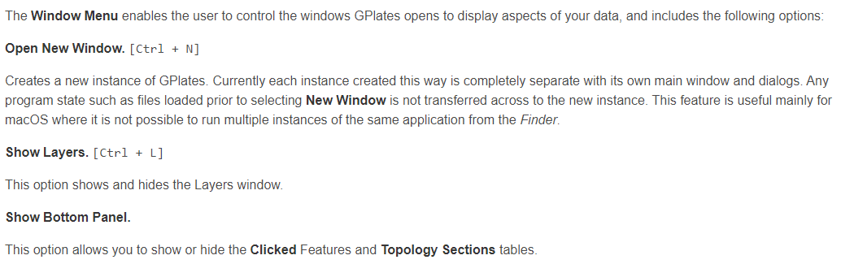
Standard Use : Important shortcuts

Slide 64
Practical Guide to Picking a Model
Notes:
Assessing plate reconstruction models using plate driving force consistency tests | Scientific Reports (nature.com)
Mind the uncertainty: Global plate model choice impacts deep‐time palaeobiological studies - Buffan - 2023 - Methods in Ecology and Evolution - Wiley Online Library

Slide 65
https://youtu.be/swGDLBOCqBg
Notes:
https://youtu.be/swGDLBOCqBg

Slide 69
Mantle RF and Palaeomag RF

Slide 70
ALWAYS
use the PMRF for Palaeontolgocial Data

Slide 71
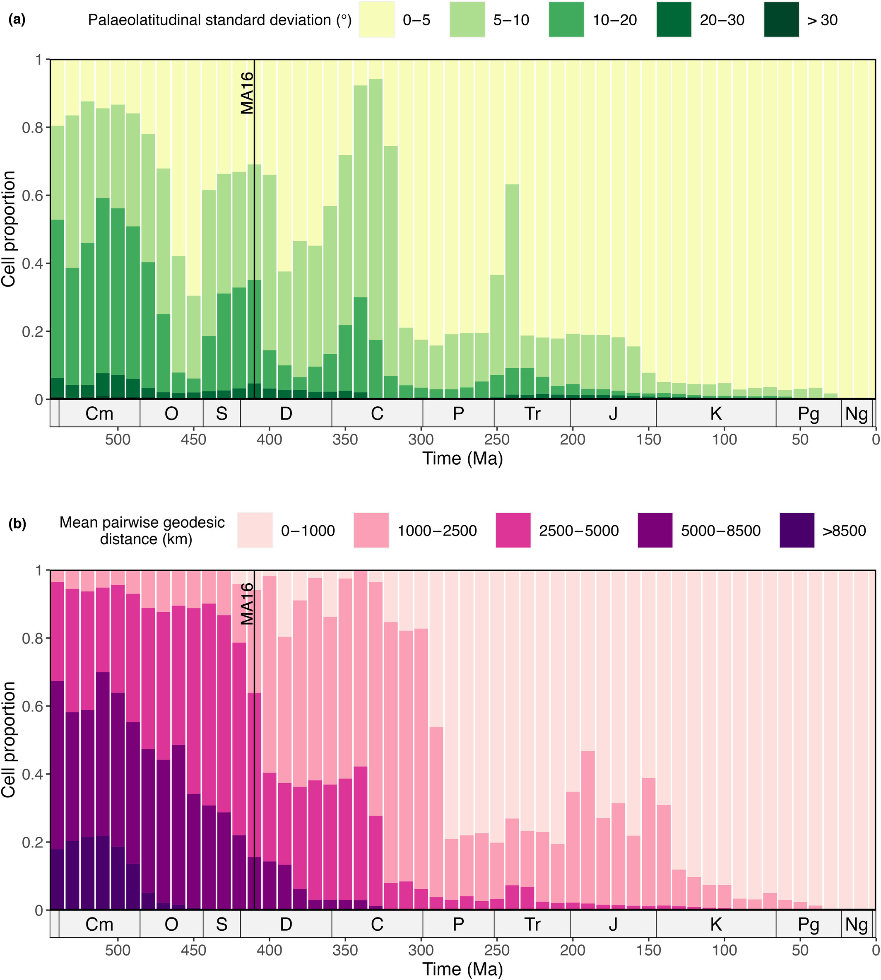
Variation within the palaeomagnetic reference frame
Buffan et al 2023
Notes:
Phanerozoic trends in spatial discrepancies between Global Plate Models within 10 Myr time steps. Values are categorised and depicted as proportions of cells. (a) Palaeolatitudinal standard deviation between reconstructed palaeocoordinates for cell centroids. (b) Mean pairwise geodesic distance between reconstructed palaeocoordinates for cell centroids. The black line depicts the temporal limit (410 Ma) of the MA16 model (Matthews et al., 2016). The bar plots show increasing palaeogeographic uncertainty between models with age of reconstruction. Period abbreviations are as follows: Cambrian (Cm); Ordovician (O), Silurian (S), Devonian (D), Carboniferous (C), Permian (P), Triassic (Tr), Jurassic (J), Cretaceous (K), Paleogene (Pg) and Neogene (Ng). The Quaternary is not depicted. The geological time scale axis was added to the plot using the R package ‘deeptime’ ver. 1.0.1 (Gearty, 2023).
Buffan et al 2023

Slide 72
Not all Plate Models are equal in all areas
test against various models.
Tomorrow why must we use the PMRF?
Gplates Tutorial 2: palaeocoordinates.

